Slide 1
BITS PILANI, WILP DIVISION M.Tech (Software Engineering) – Dissertation APPLICATION OF ARTIFICIAL INTELLIGENCE TECHNIQUES IN SOFTWARE TEST AUTOMATION

Slide 2
APPLICATION OF AI TECHNIQUES IN SOFTWARE TEST AUTOMATION
Pattern Recognition in production defects to identify similar patterns in new data, aiding in the recognition of common root causes
MALLISWARI RAMA RAJU
2022MT93202

Slide 3
Introduction
Artificial Intelligence (AI) in software test automation has revolutionized the testing process by enabling tasks like test case generation, execution and analysis to be performed more efficiently and accurately. AI algorithms can analyze vast amounts of data to identify patterns, predict defects, and optimize testing workflows, ultimately improving software quality and reducing time-to-market.

Slide 4
Problem Statement
To provide a comprehensive exploration of pattern recognition techniques using AI in the context of software production defects, offering insights into their effectiveness, practical applications and potential challenges. Through empirical studies and analysis, it seeks to contribute to the advancement of defect analysis methodologies and support the development of more robust and reliable software systems.

Slide 5
Production Defects RCA
Root Cause Analysis (RCA) of software defects in production is a systematic process for identifying the underlying causes of the defects.
The manual RCA process includes analysing the production defect description, analysing the customer data in database, analysing the codebase and configuration, then identifying the root cause as a Design/Database/Code issue or missed requirement or not a defect.
Based on the root cause and finalized defect fix, “Resolution” field in Rally is filled with appropriate resolution of “Design/Code Change”, “Database Change”, “Converted to a User Story”, “Not a Defect” or “Duplicate Defect”.

Slide 6
Scope
Production defect RCA has been identified as a Classification problem. The primary focus to address the problem is on how AI-based pattern recognition can aid in root cause analysis of software defects and predict their Resolution, based on existing defects, using supervised learning-based classification model.
Current scope of dissertation includes defect data collection, data pre-processing, splitting data into training and test data, implementing supervised learning model for predicting “Resolution” for test data, and measuring accuracy of prediction on test data.
The dissertation has been implemented as a POC (Proof of Concept) in Optum due to database and code integration limitations described in next slide.

Slide 7
Limitations
Dataset size – Production defects data could be gathered for 2023 and 2024 only, as Rally became the source of truth for prod defects from 2023. This limited the dataset size to less than 1200 records, which posed challenges for training complex predictive AI models.
Data Quality – Prod defects description is not in consistent format and, lacks enough details, as the prod support team is not trained to log defects consistently.
Data and Code Confidentiality – Optum is a US based healthcare insurance organization. Since Cirrus is a member enrolment application, its database consists of member PII (Personal Identifiable Information) and PHI (Protected Health Information), which is confidential and restricted from sharing outside the organization. Cirrus codebase is strictly confidential and cannot be accessed outside, as per company security policies. These limitations do not allow database and code integration with the AI model, reducing the scope and accuracy of the model.

Slide 8
Approach
Automation of Production Defect RCA to predict the root cause of defects is identified as a Classification problem, as the defects need to be categorised as ”Design/Code Issue”, “Database Issue”, “Missed Requirement”, “Not a Defect”, “Duplicate”.
The framework implements supervised learning-based AI/ML model, encompassing the below steps:
Data Collection & Pre-Processing
Split dataset into Training and Test Datasets - Using a test_size of 0.2, the proportion of dataset to include in test split is defined as 20%, while 80% is used for training. Random_state of 42 is used to ensure efficiency of the model as the training and test datasets will remain the same whenever code is run.
Use machine learning Classification Model XGBoost (Extreme Gradient Boost) to classify and predict the “Resolution” in test dataset
Github Link - https://github.com/msarraj27/Dissertation.git

Slide 9
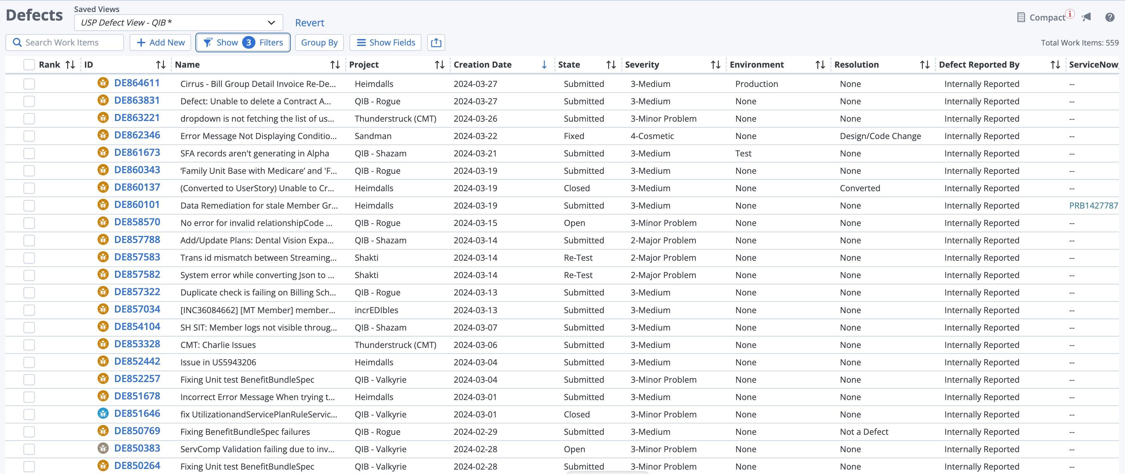
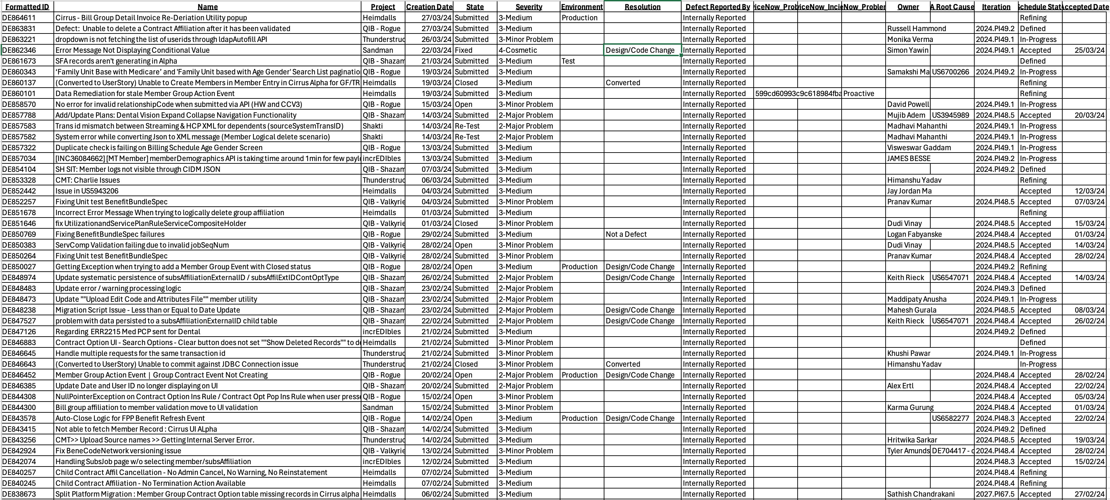
Data Collection

Slide 10
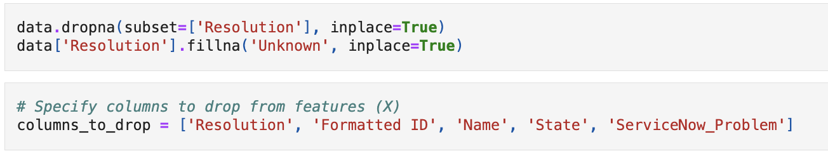
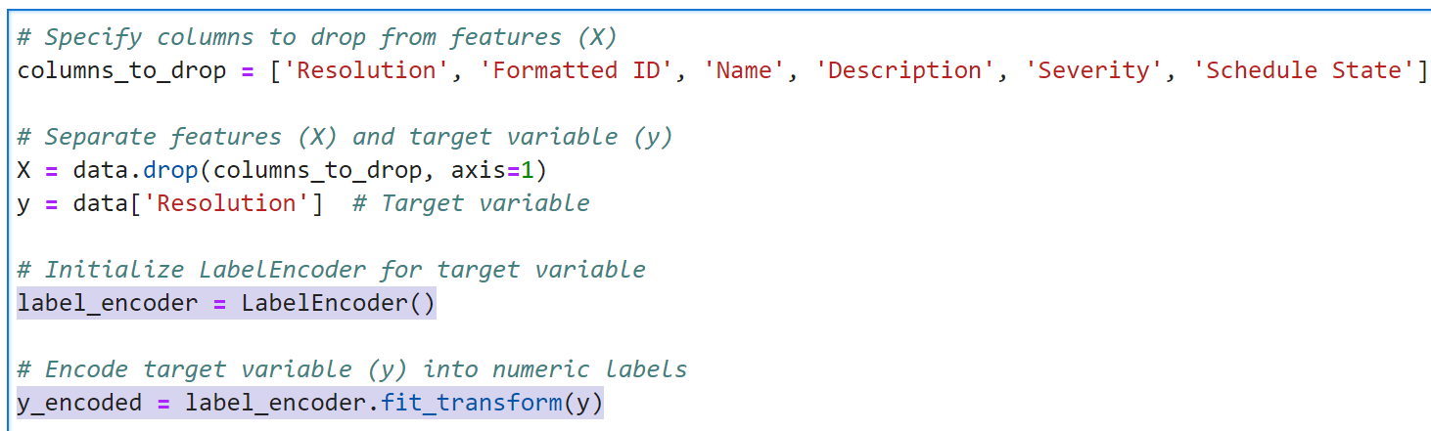
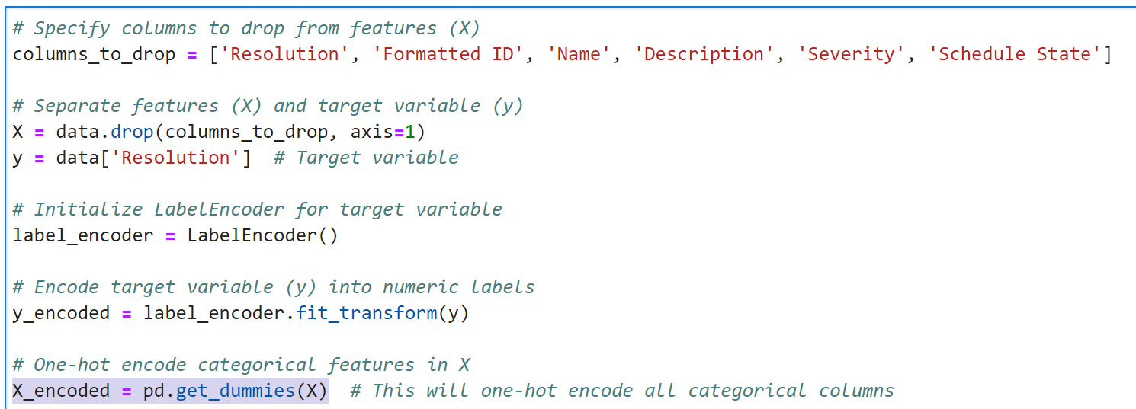
Data Pre-Processing
Dropping not required columns and filling missing values
LabelEncoder() for encoding the target variable “Resolution” into numerical labels.
get_dummies() function for performing one-hot encoding on input variables of the dataset

Slide 11
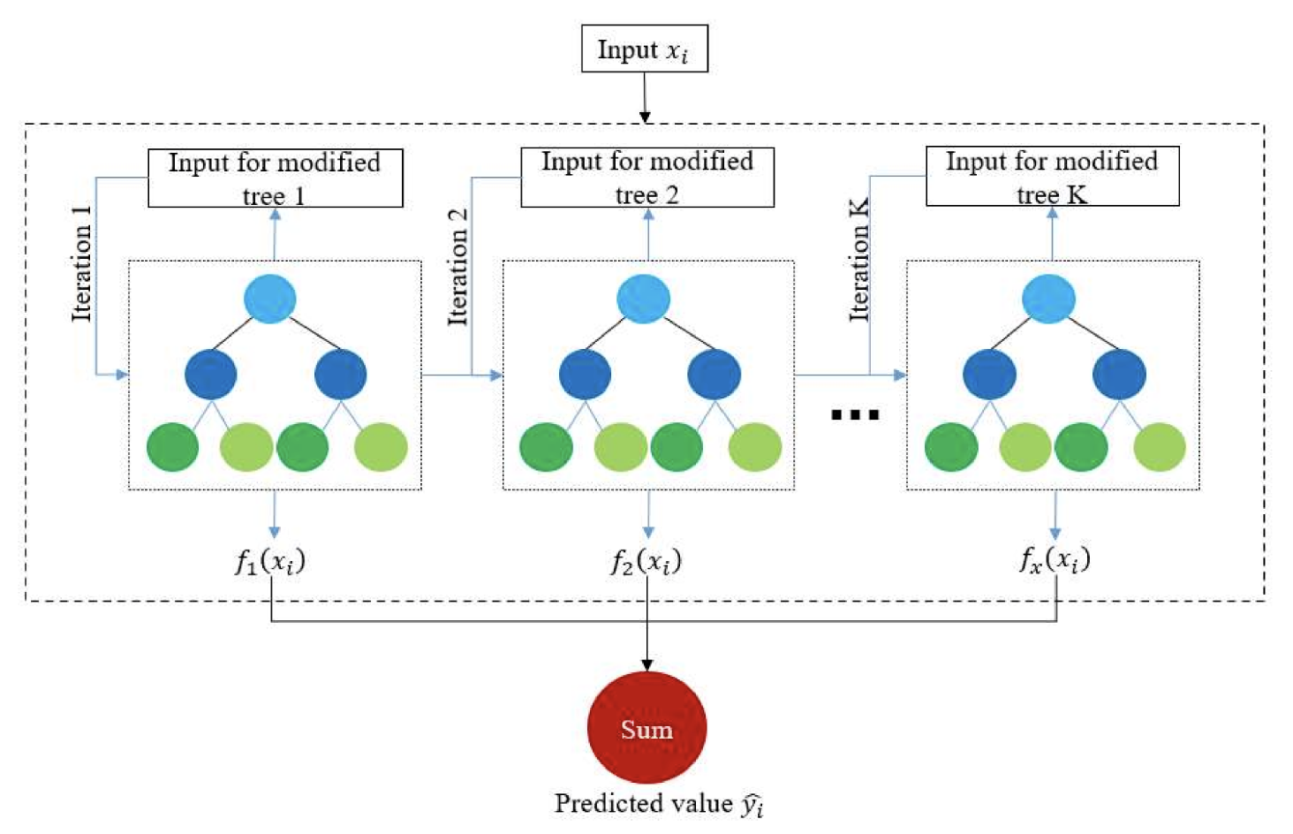
XGBoost
XGBoost is an optimized distributed gradient boosting library designed for efficient and scalable training of machine learning models.
It is an ensemble learning method that combines the predictions of multiple weak models to produce a stronger prediction.
XGBoost stands for “Extreme Gradient Boosting” and it has become one of the most popular and widely used machine learning algorithms due to its ability to handle large datasets and its ability to achieve state-of-the-art performance in many machine learning tasks such as classification and regression.

Slide 12
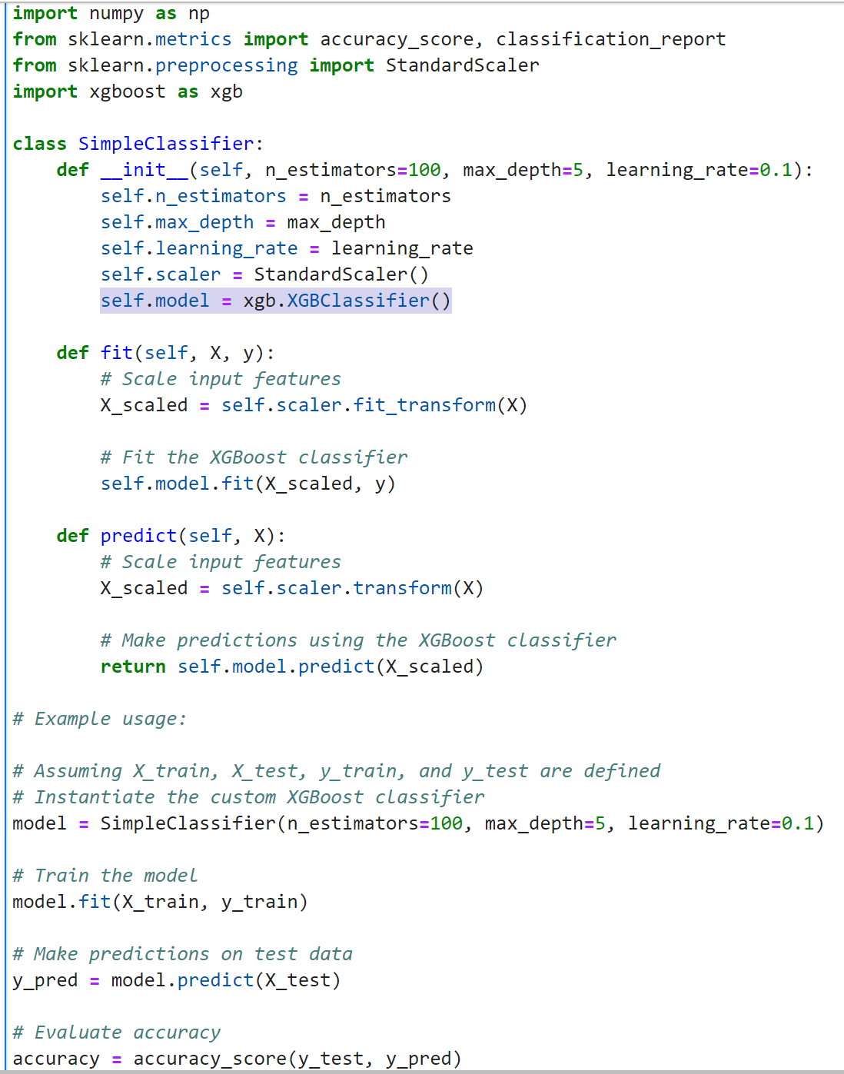
XGBoost Algorithm for RCA
Use machine learning Classification Model XGBoost (Extreme Gradient Boost) to classify and predict the “Resolution” in test dataset.
Self.model variable is to store the initialized XGBClassifier model instance. Storing the model as self.model attribute allows easy access to the model within the class methods and facilitates training and prediction tasks.
Once the model is initialized, training on training data, evaluating its performance and making predictions on new data is achieved.

Slide 13
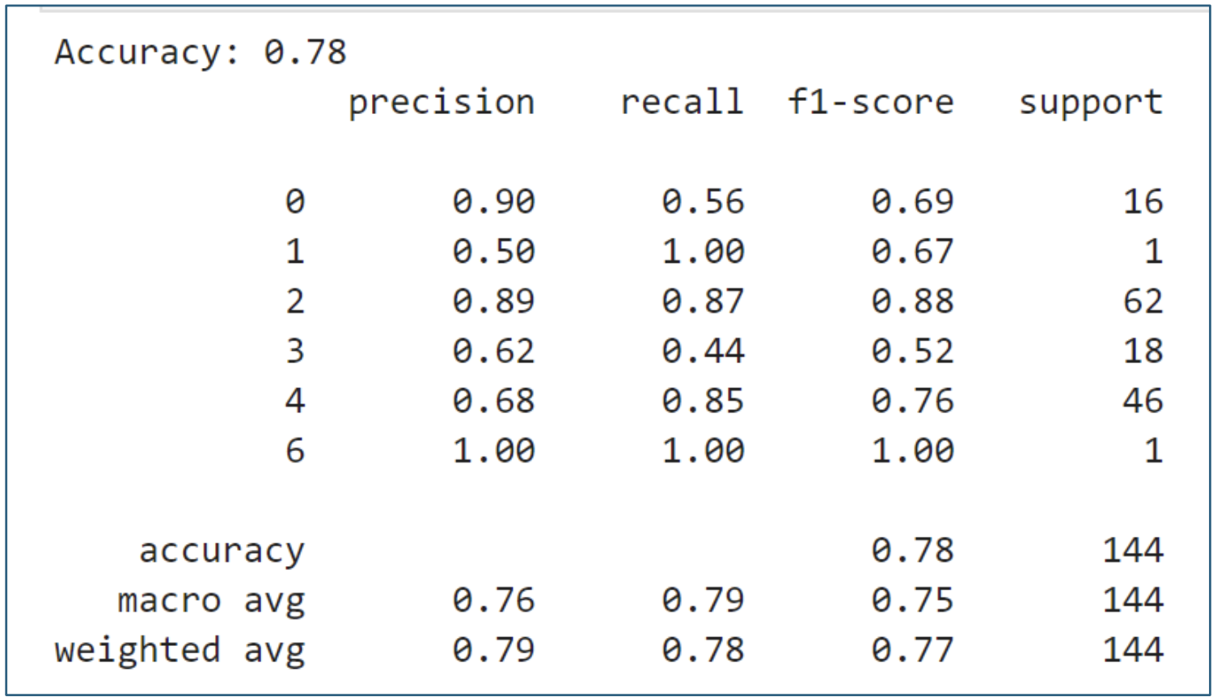
Evaluation & Metrics
Accuracy of 78% for predicting Resolution of production defects in test dataset is achieved with the implemented AI model.
Precision – It is a measure of the correctness of positive predictions. The precision values range from 0.50 to 1.00, with an average weighted precision of 0.79.
Recall – Also known as Sensitivity or True Positive Rate, it is a measure of the model’s ability to correctly identify all positive instances. Recall values range from 0.44 to 1.00, with an average weighted recall of 0.78.
F1-Score – It is the harmonic mean of precision and recall, providing a balance between the two metrics. F1-score values range from 0.52 to 1.00, with an average weighted f1-score of 0.77.
Support – It indicates the number of actual occurrences of each class in the test set.

Slide 14
Conclusions & Recommendations
With the current limitations on dataset and company policy restrictions, accuracy, precision, recall and f1-score values are reasonable. The POC is done to showcase that artificial intelligence is a promising solution to predict RCA of production defects.
With consistent and extensive dataset, and proper database and codebase integration, Generative AI models can be implemented for higher accuracy and prediction of defects based on the customer data.
Future Scope:
Deployment:
Train prod-support team to maintain Rally defects consistently. The business requirement is to create a simple automated RCA approach that will be used for problem avoidance in future [2].
Once extensive dataset is available, enhance the current model to implement Gen AI to predict RCA.
Demo the model to team & MLRB (Machine Learning Review Board) and get their approval.
Upon getting the approval, deploy the model to Rally production defects.
Feedback Loop:
1. Incorporate feedback from users and domain experts to continuously improve the model's accuracy and effectiveness.

Slide 15
Benefits of Automation
Speed, Efficiency & Scalability: AI model can analyse large volumes of data quickly, accelerating the RCA process and reducing manual effort.
Accuracy: The AI algorithm can detect patterns and correlations in complex data sets more accurately than humans, leading to more precise identification of root causes.
Predictive Insights: The model can uncover hidden relationships between variables, helping predict potential defects before they occur, and thus enable proactive defect prevention.
Continuous Improvement: By automating RCA, team can continuously learn from past defects and refine our processes to enhance overall software quality over time.
Resource Optimization: Automated RCA frees up human resources from repetitive tasks, allowing us to focus on more strategic activities like implementing preventive measures and improving overall development practices.

Slide 16
Disadvantages of Automation
Data Quality
Lack of Contextual Understanding
Limited Explanation of Findings
False Positives and Negatives
Maintenance and Updates
Ethical and Bias Concerns
Skill Requirements

Slide 17
Thank You

